Slide 1




Sentiment Analysis on Product Reviews
Machine Learning and Deep Learning Approaches
November 1, 2024.

Slide 2

MOHAMMAD AHMAD ELSHORAKY
YUSUF SAAD
SALEH KOTB
OUR
TEAM
WEAAM ELSAYED
REHAB KHALED ELESAWY

Slide 3


CONTENT
01
02
03
04
Introduction
Tools and Technologies
Data Exploration (EDA)
Modeling Approaches
05
06
07
08
Experiment Tracking with MLflow
Results and Performance
Model Deployment
Conclusion

Slide 4



Introduction
Objective: To classify customer reviews as positive or negative.
Project Scope: Data processing, analysis, machine learning, deep learning, tracking, and deployment.

Slide 5

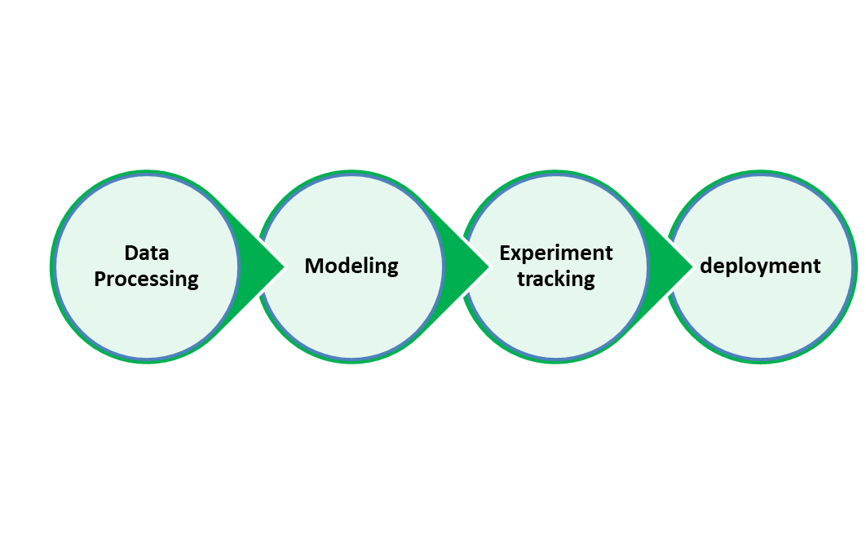
Tools and Technologies
Data Processing: Python, Pandas, NLTK.
Modeling: Scikit-learn, TensorFlow, BERT.
Experiment Tracking: MLflow.
Deployment: Flask, Postman.

Slide 6
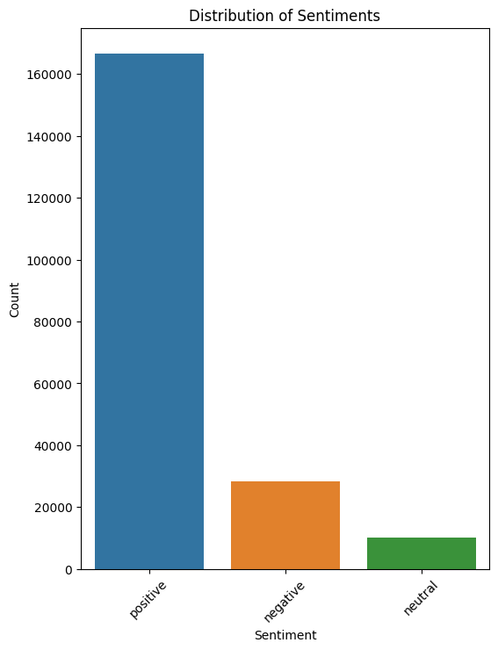
Dataset Overview
Source: Kaggle Flipkart product review dataset.
Main Features: Product name, price, review, rating, summary, sentiment label.
Challenge: The data was imbalanced with more positive reviews than negative, requiring strategies to handle class imbalance.

Slide 7
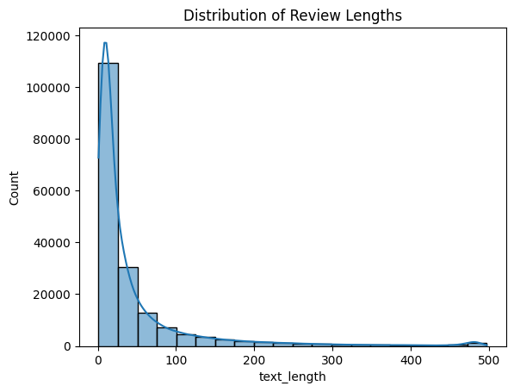
Data Exploration (EDA)
Exploratory Data Analysis (EDA) was performed to gain insights into:
data distribution and key insights before model building."
Show sentiment distribution to illustrate the imbalance between positive and negative reviews.
"Analyzed review length to understand typical customer review detail."

Slide 8


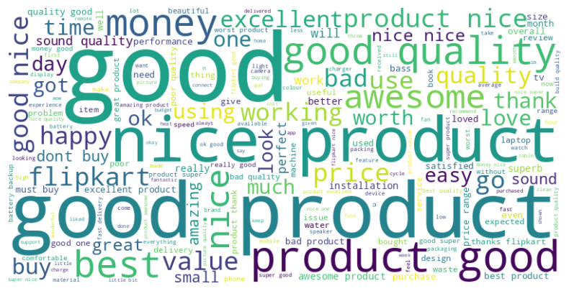
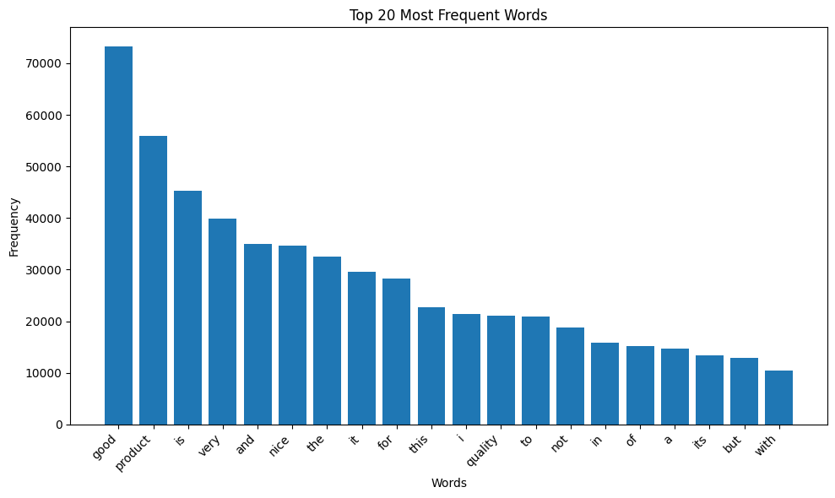

Data Exploration (EDA)
We examined frequently used words in both positive and negative reviews to identify common themes.
Observed commonly used words can highlight specific product strengths or weaknesses.

Slide 9
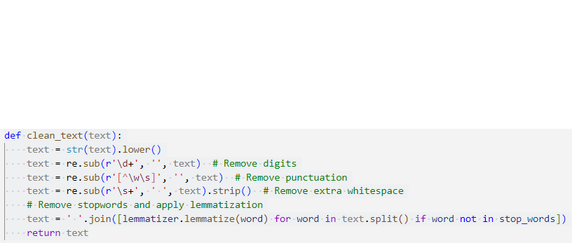
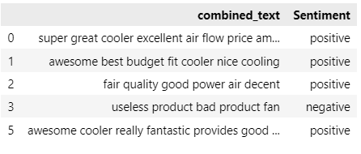
Data Preprocessing
Text Cleaning and Preparation:
Converted text to lowercase
Eliminated digits, punctuation, whitespace.
Applied lemmatization
Eliminated stopwords
Checked for and dropped missing values
Merged the "Review" and "Summary" columns to create a "combined_text" column.
Excluded neutral sentiments to concentrate on binary classification.

Slide 10
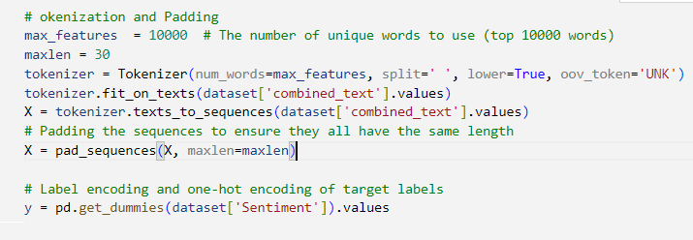
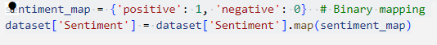
Data Preprocessing
Tokenization and padding :
Tokenized text to generate sequences from the top 10,000 words.
Implemented padding to maintain a consistent input length of 30 words.
Label Encoding:
Mapped sentiments to binary values: positive (1) and negative (0).
Utilized one-hot encoding for labels to meet model requirements.
Result:
Compiled a dataset featuring standardized text sequences alongside binary sentiment labels.

Slide 11
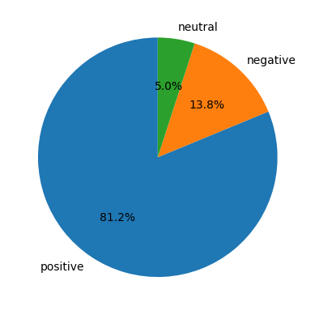

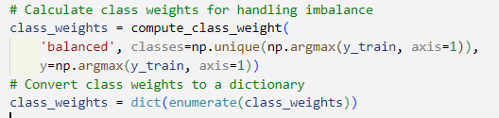
Data Preprocessing
Addressing Class Imbalance:
Used `class_weight` parameter to prioritize the minority class.
Why `class_weight`?
Adjusts the model's loss function for imbalance.
Improves generalization and accuracy for both classes.
Outcome:
Decreased bias towards the majority class, leading to balanced model performance.

Slide 12
Modeling Approach
Machine Learning Models
Model | Accuracy | Precision | Reall | F1 Score
Random Forest | 97.43 % | 97.63 % | 99.72 % | 98.82 %
Decision Tree | 96.00 % | 97.68 % | 97.60 % | 97.64 %
KNN | 94.44 % | 95.86 % | 97.84 % | 96.84 %
Logistic Regression | 94.53 % | 98.28 % | 95.39 % | 96.81 %
XGBoost | 92.69 % | 97.75 % | 93.76 % | 95.72 %

Slide 13
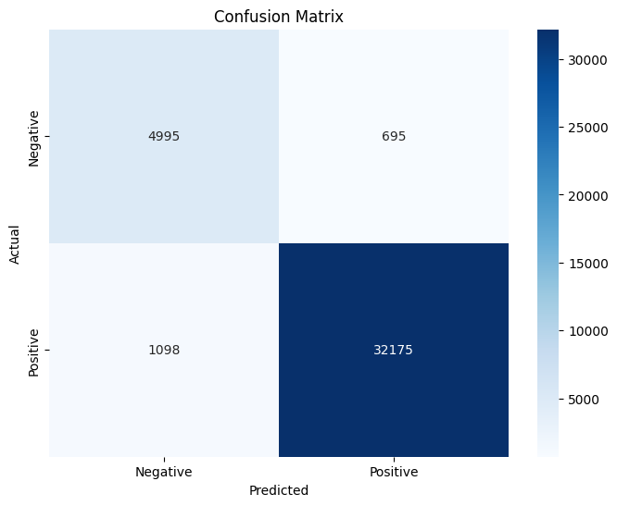
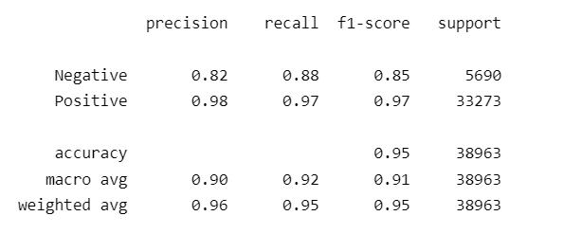
Modeling Approach
RNN Model
RNN (Recurrent Neural Network) was used to identify sequential patterns in text data:
Architecture featured embedding and RNN layers for enhanced text representation.
Training involved padded sequences and class weights for balance.

Slide 14

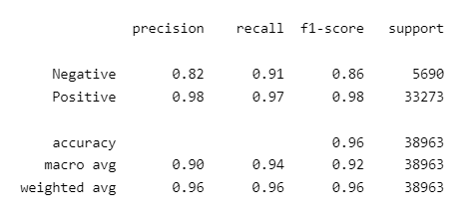
Modeling Approach
LSTM Model
Used an LSTM network for better performance on sequence data
Result:
Achieved higher accuracy with
LSTM compared to traditional
models.

Slide 15
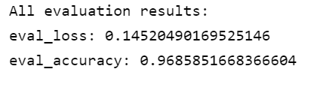
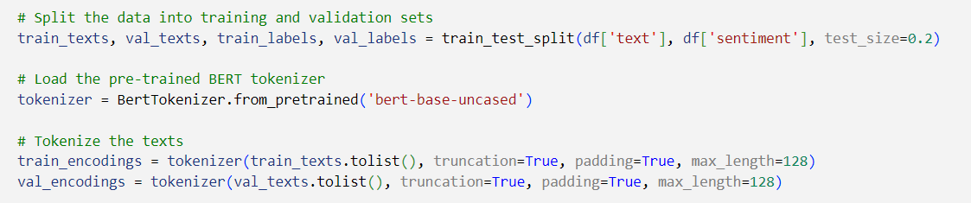
Modeling Approach
BERT Model
BERT was used to enhance the model’s performance by leveraging contextual understanding of words in the reviews.
Why BERT?: Pre-trained model that understands word context in a deep way.
Result:
Achieved higher accuracy

Slide 16

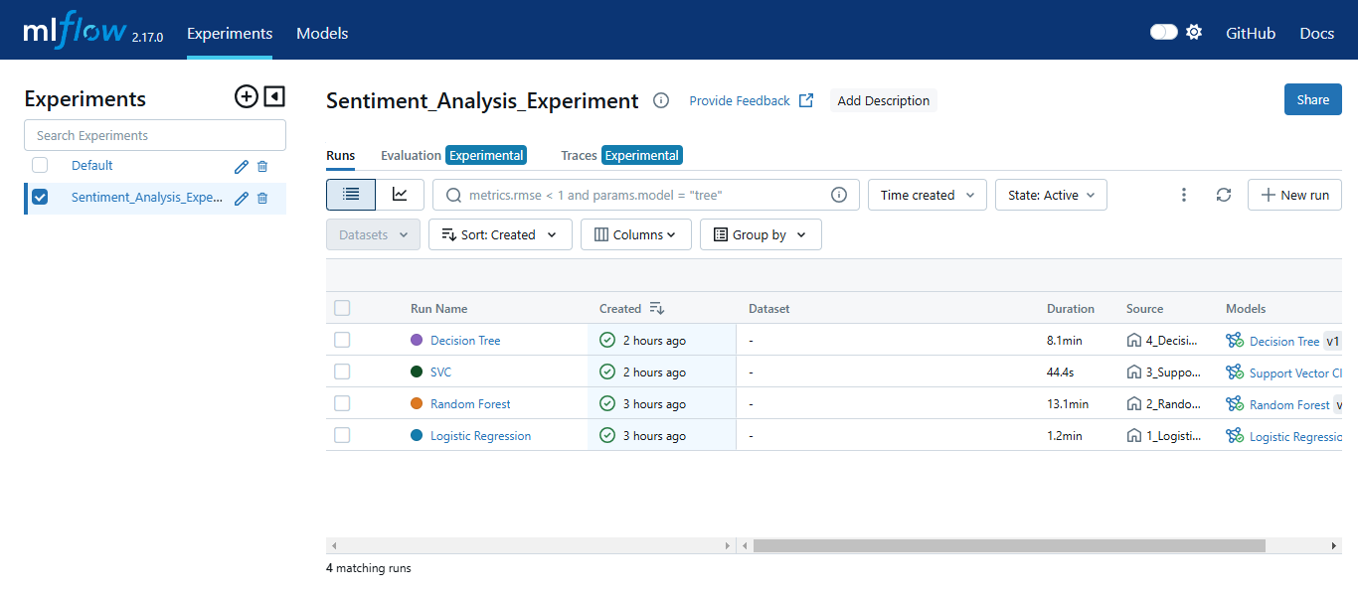
Used for tracking experiment metrics, comparing models, and managing runs in a structured way
clear performance comparison
tracks model parameters
and helps in identifying the best-performing model.

Slide 17
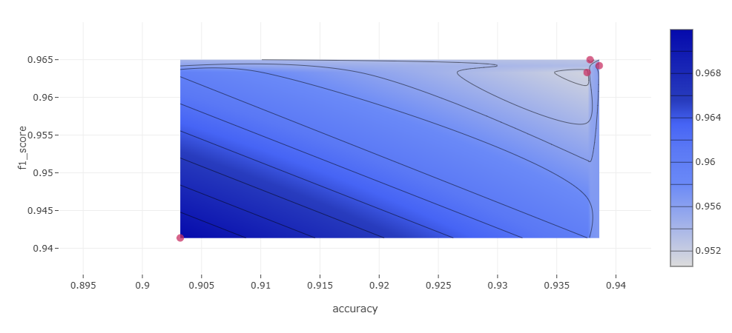
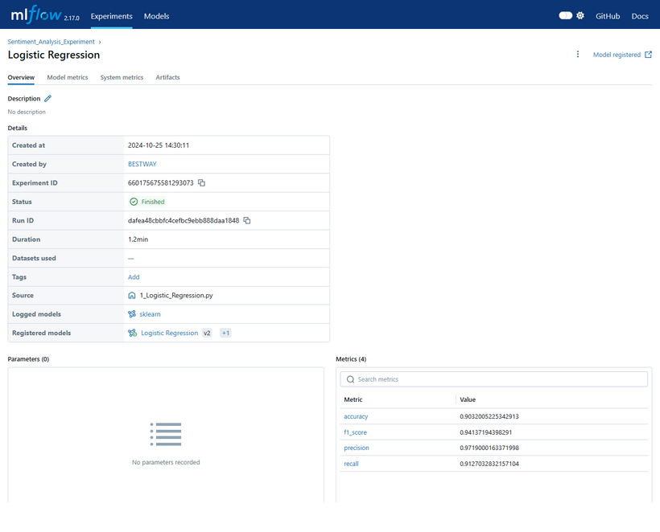
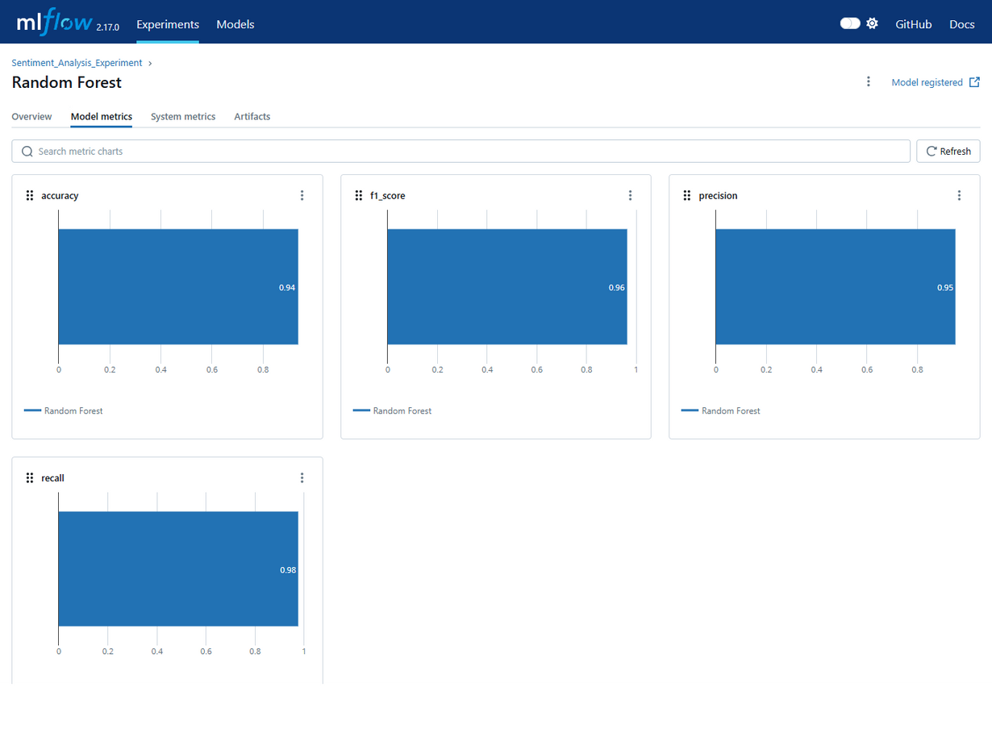
Model Tracking
Structured Experiment Tracking:
Organizes experiments for easy access and review.
Comprehensive Metric Logging:
Captures important performance metrics (e.g., accuracy, precision, recall) throughout model training.
Visual Comparison of Runs:
Quickly compare different runs and configurations to find the optimal model setup.

Slide 18
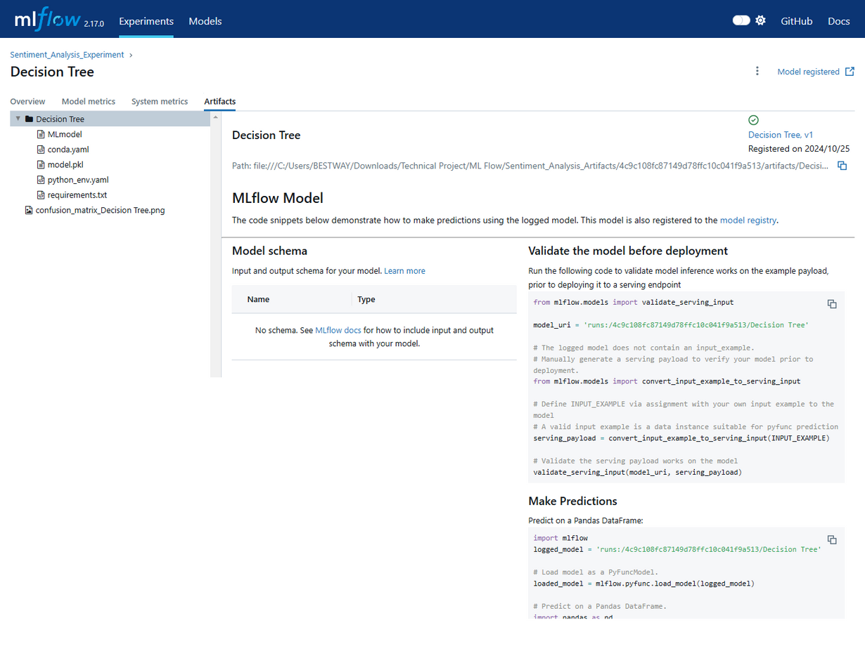
MLflow Models
Unified Model Packaging:
Standardizes model format for easy sharing and compatibility across platforms.
Reproducible Environments:
Includes environment specifications, making it easy to load and use models consistently.
Artifact Management:
Stores artifacts alongside models, including custom objects and necessary resources.

Slide 19
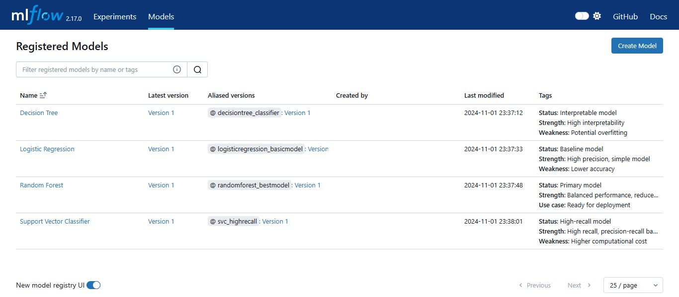
Model Registry
Centralized hub for:
Versioning models
Lifecycle management (staging, production)
Storing metrics for easy comparison
Deployment-ready tracking.
Registered Models:
Decision Tree
Logistic Regression
Random Forest
Support Vector Classifier

Slide 20

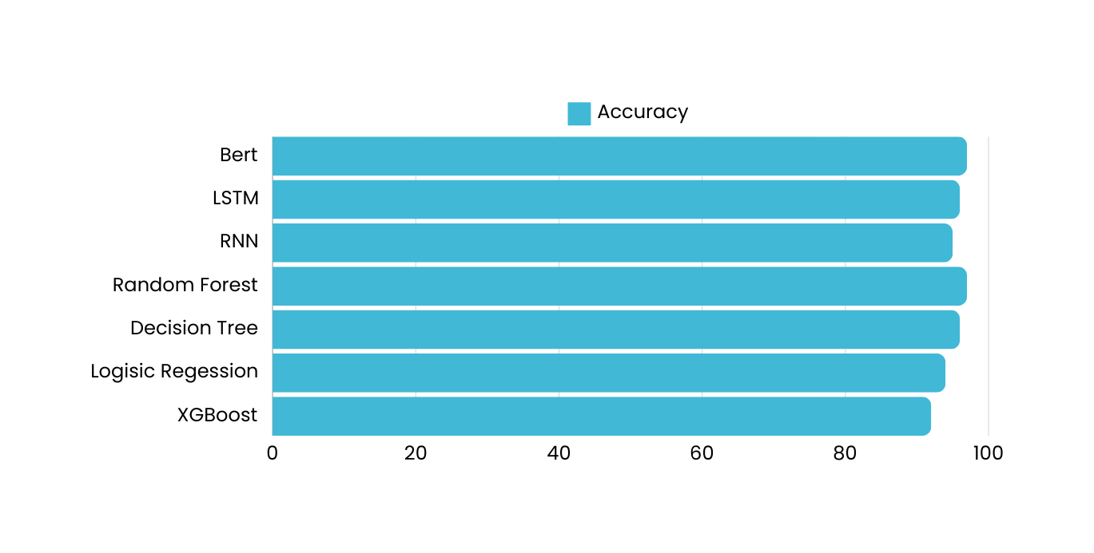
Results & Comparison
97%
96%
95%
97%
96%
94%
92%

Slide 21
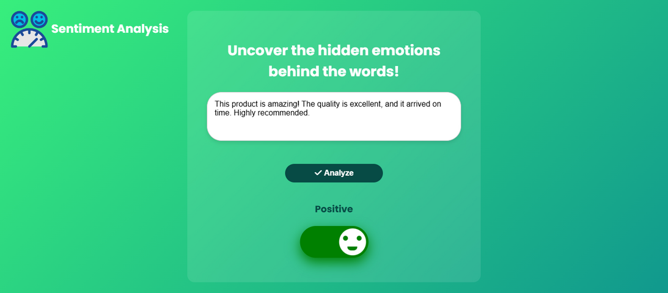
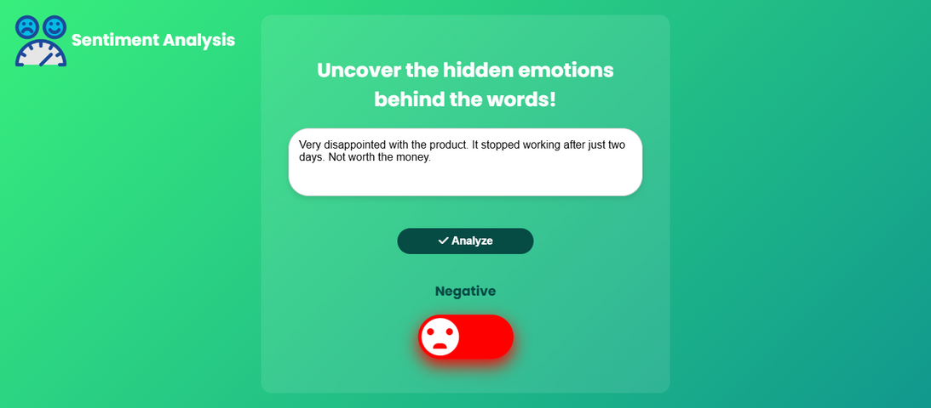


Model Deployment - Flask & Postman
Benefits:
Scalable
accessible
ready for application integration.
Deployment Steps:
Flask created API endpoints for the model.
Postman tested and enabled real-time review classification.

Slide 22
Conclusion
This project successfully built a sentiment analysis pipeline to classify Flipkart product reviews. Starting with data preprocessing and handling class imbalance, we applied various models, including Logistic Regression, Random Forest, LSTM, and BERT, achieving strong classification performance. Using MLflow, we tracked and compared models to select the best one for deployment. The final model, deployed via Flask, enables real-time sentiment analysis, offering valuable insights into customer feedback for businesses.

Slide 23
Any
Questions

Slide 24




Thank you
GitHub Repository
Project Code on GitHub

